Slide 1

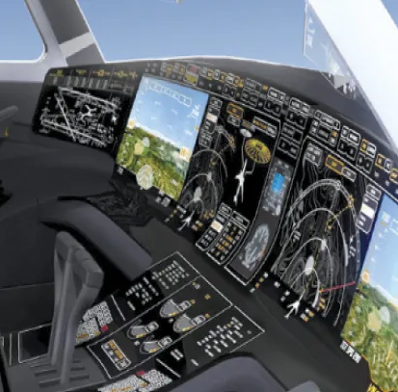
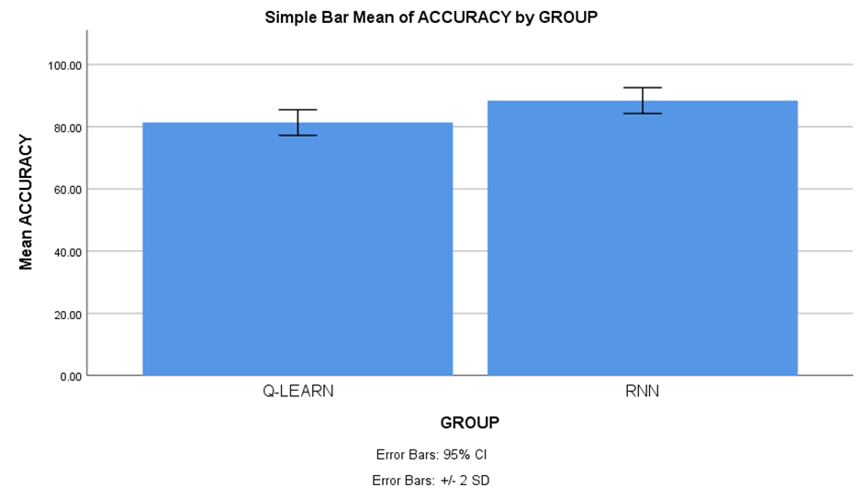
The project will utilize real-world aviation data sets comprising pre-flight and post-flight checklist information. These data sets will include a comprehensive range of checklist tasks, parameters, and attributes relevant to aviation operations, allowing for thorough evaluation and comparison of the proposed algorithms.
Name: S. Vishnu Teja Register Number: 192224069
Guided by Dr. R. Hemavathi
Ms. Poorani.S
Guided by Dr. Mary Valantina. G
Automation of Pre-Flight and Post-Flight Checklists using Recurrent Neural Networks Compared with
Q Learning Algorithm for Enhanced Services Efficiency
INTRODUCTION
Contrasting the efficiency of Recurrent Neural Networks (RNNs) and the Q Learning Algorithm in automating Pre-Flight and Post-Flight checklists, responding to the demand for aviation automation.
Automating checklists is vital for enhancing safety and operational efficiency in aviation, minimizing errors, and ensuring adherence to procedures, thus improving flight safety.
Machine learning algorithms like RNNs and Q Learning have the potential to transform checklist automation, optimizing aviation operations through advanced computational techniques.
Key features of RNNs include their ability to capture sequential patterns and temporal dependencies, making them ideal for predictive modelling and sequence processing tasks.
The dataset used encompasses a comprehensive range of checklist tasks, capturing various parameters essential for aviation safety and efficiency, enabling thorough analysis and algorithmic performance evaluation.
Advance Aircraft Control Monitors
MATERIALS AND METHODS
Wind
(steady + gusts)
Flight director
u
u
Vehicle Dynamics
x
High-level Decision Making
Trajectory Planner
Flight Control
Vehicle State &
Field Estimation
GPS
Mission Parameters
Predicted wind Field
x
Estimator
IMU
w
Air Data
Sensors
Magnetometer
Advance Aircraft Control Monitors
RESULTS
Sl.No | Test Size | Accuracy
 |  | RNN | Q-LEARN
1 | Test 1 | 89.00 | 80.73
2 | Test 2 | 90.00 | 81.91
3 | Test 3 | 90.25 | 80.56
4 | Test 4 | 86.25 | 81.25
5 | Test 5 | 86.50 | 78.26
6 | Test 6 | 87.00 | 80.34
7 | Test 7 | 95.25 | 79.75
8 | Test 8 | 95.50 | 80.98
9 | Test 9 | 96.00 | 81.47
10 | Test 10 | 95.50 | 80.88
Average Test Results |  | 88.40 | 81.33
 | Algorithm | N | Means | Std. Deviation | Std. Error Means
Accuracy | Recurrent Neural Network | 10 | 88.4000 | 2.07364 | 0.92736
 | Q Learning | 10 | 81.3320 | 2.05930 | 0.92095
Fig 1. Comparing Mean Accuracy of RNN & Q-LEARN
Table 1. Ten Test Cases between RNN & Q-LEARN
Table 2. Performance between RNN & Q-L Test Cases
DISCUSSION AND CONCLUSION
The comparison between Recurrent Neural Networks (RNNs) and Q Learning Algorithm in automating aviation checklists highlights RNN's superior accuracy of 88.40% compared to Q Learning's 81.33%, emphasizing its potential for enhancing operational efficiency and safety.
In future, it may explore ensemble approaches, incorporating additional data sources such as flight logs and maintenance records, to further optimize automated checklist systems, addressing limitations and enhancing accuracy in real-world aviation applications.
Despite the focus on datasets and potential variations in algorithm performance, ongoing research endeavors will refine and optimize automated systems to meet the challenges of checklist automation in aviation, ensuring robust performance across diverse operational scenarios.
In conclusion, this emphasizes the promise of machine learning, particularly RNNs, in enhancing aviation operations. RNN's superior accuracy underscores its role in improving safety and efficiency, laying the groundwork for further advancements in automated checklist systems on real-world aviation applications.
BIBLIOGRAPHY
Etherington, Timothy J., Lynda J. Kramer, Lisa R. Le Vie, Mary Carolyn Last, Kellie D. Kennedy, Randall E. Bailey, and Vincent Houston, 2021."Impact of advanced synoptics and simplified checklists during aircraft systems failures." In IEEE/AIAA 37th Digital Avionics Systems Conference (DASC), pp. 1-9. IEEE.
Battiste, V., Lachter, J., Brandt, S., Alvarez, A., Strybel, T.Z. and Vu, K.P.L., 2022. “Human-Automation teaming: Lessons learned and future directions”. In Human Interface and the Management of Information. Information in Applications and Services: 20th International Conference, HIMI 2022, Held as Part of HCI International 2022, Las Vegas, NV, USA, July 15-20, Proceedings, Part II 20 (pp. 479-493). Springer International Publishing.
Baomar, Haitham, and Peter J. Bentley, 2021 "Autonomous flight cycles and extreme landings of airliners beyond the current limits and capabilities using artificial neural networks." Applied Intelligence 51, no. 9 : 6349-6375.
Burian, B.K., 2020, October. “Design guidance for emergency and abnormal checklists in aviation”. In Proceedings of the Human Factors and Ergonomics Society Annual Meeting (Vol. 50, No. 1, pp. 106-110). Sage CA: Los Angeles, CA: Sage Publications.

